Slide 1
Emotion Detection From Tweets And Emoticons
Made by-
Jain Rajat Ashok(22)
Dubey Arun Kumar Vyas (14)
Kshatriya Sawan Ranjan(32)
Shukla Pratyush Suresh(58)

Slide 2
Abstract
  Micro blogging sites have millions of people sharing their thoughts daily because of its characteristic short and simple manner of expression. We propose and investigate a paradigm to mine the sentiment from a popular real-time micro blogging service, Twitter, where users post real time reactions to and opinions about “everything”.
  Social networking sites like twitter, Facebook, etc. are the great source of communication for internet users. So these become an important source for understanding the opinions, views or emotions of people.
  We extract data, i.e. tweets from Twitter in real time and apply machine learning techniques to convert them into a useful form and then use it for building sentiment classifier. Given a piece of written text, the problem is to categorize the text into one specific sentiment polarity i.e. positive, negative or neutral.

Slide 3
Problem Statement
• Text Level Analysis:
Given a message, we decide whether the message is of positive negative or neutral sentiment.
For messages conveying both a positive, negative sentiment, whichever is the stronger sentiment should be chosen.
•Emojis Level Analysis :
Given a emoji whether that instance is positive, negative in that context.

Slide 4
OBJECTIVE
Using algorithm to classify text and emoticons into positive, negative or neutral.
Emotion detection is to analyze attitude of the mass is positive, negative or neutral towards the subject of interest.
Sentiment analysis extracts information from the opinions, appraisals and emotions of people in regards to entities, events and their attributes.

Slide 5
The objective of this project is to show how sentimental analysis can be used to recognize user’s mood or emotion using tweets which has been extracted in real time.
The learning algorithm will then learn what our emotions are from statistical data and then determine the emotion.

Slide 6
Scope :
The amount of relevant data is much larger for twitter, as compared to traditional blogging sites.
Moreover, the response on twitter is more prompt and also more general (since the number of users who tweet is substantially more than those who write web blogs on a daily basis).
This could be done by analyzing overall public sentiment towards that firm with respect to time and using economics tools for finding the public sentiment.
Firms can also estimate how well their product is responding in the market, which areas of the market is it having a favorable response and in which a negative response.

Slide 7
Motivation :
Sentimental analysis is a hot topic of research.
Use of electronic media is increasing day by day.
It can lead to more accurate tools for extracting semantic information.
It provide means for empirically studying properties of social interaction.

Slide 8
Literature Review :
Year | Tittle | Author | Methods/Algorithm used | Publication
2017 | Sentimental analysis with Recurrent neural network and unsupervised neural language model | Abdalraouf Hassan, Ausif Mahmood | Recurrent Neural Network Long Short-Term Memory (RNN-LSTM)
2016 | Sentiment Analysis on Twitter Data-set using Naïve Bayes Algorithm | Huma Parveen, Prof. Shikha Pandey | Naïve Bayes Algorithm | IEEE
2013 | Sentiment Analysis in Twitter using Machine Learning Techniques | Neethu M S, Rajasree R | Naive Bayes (NB), Maximum Entropy (ME), and Support Vector Machines (SVM) | IEEE

Slide 9
Year | Tittle | Author | Algorithm used | Publication
2015 | Emotion Analysis of Twitter using Opinion Mining | Akshi Kumar, Prakhar Dogra and Vikrant Dabas | A two-step approach is proposed, to identify the sentiment; extract the opinion words (a combination of the adjectives along with the verbs and adverbs) in the tweets and subsequently use a novel algorithm to find the emotion values of opinion words.

Slide 10
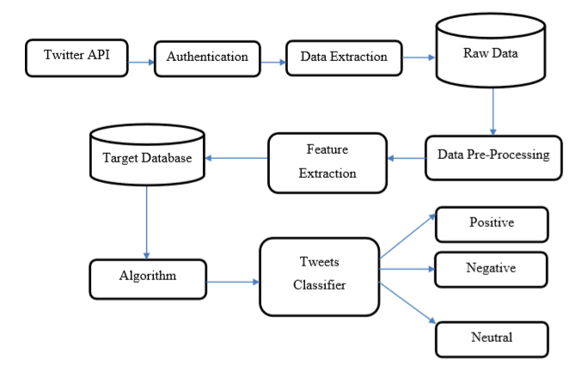
PROPOSED SYSTEM

Slide 11
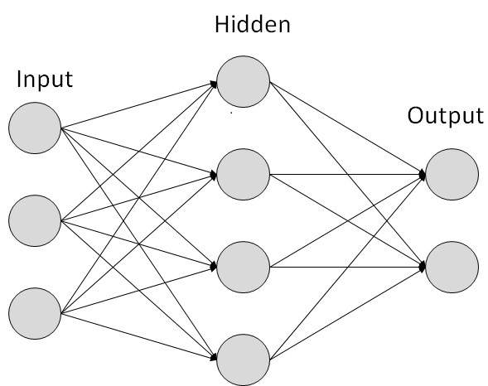
METHODS AND ALGORITHM
A Recurrent Neural Network (RNN) is a class of artificial neural network where connections between nodes form a directed graph along a sequence. This allows it to exhibit temporal dynamic behavior for a time sequence. Unlike feedforward neural networks , RNNs can use their internal state (memory) to process sequences of inputs. This makes them applicable to tasks such as unsegmented, connected handwriting recognition or speech recognition.

Slide 12
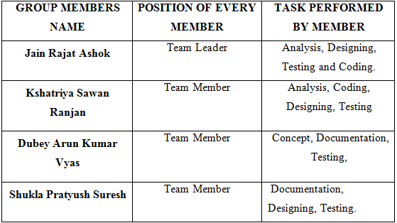
Implementation Details

Slide 13
import twitter4j.*;
import twitter4j.auth.OAuth2Token;
import twitter4j.conf.ConfigurationBuilder;
import java.io.BufferedWriter;
import java.io.FileWriter;
import java.io.IOException;
import java.util.List;
import java.util.Map;
public class TwitterProject {
public static void main(String [] args) throws TwitterException, IOException{
ConfigurationBuilder cb = new ConfigurationBuilder();
cb.setDebugEnabled (true)
.setOAuthConsumerKey ("ExhS1Ua9U8mDgYOR6vFytEWzw")
.setOAuthConsumerSecret ("wfRgBtPLVPcrmuF2I9lk55fkp7hvUr706FdBsi9u1NWnuROy3q")
.setOAuthAccessToken ("1047828476626124800-E6Z7c4elvTLVHsSrYdgOYUasSY18d3")
.setOAuthAccessTokenSecret ("j8fGHB2E71YvQj3nK8JAI2ZZ4NM3JoXEVg95JHcokjllX");
TwitterFactory tf = new TwitterFactory (cb.build ());
Twitter twitter = tf.getInstance ();
Query query = new Query(“navrathri");
QueryResult result = twitter.search(query);
do{

Slide 14
List<Status> tweets = result.getTweets();
StringBuilder sb = new StringBuilder(); for(Status tweet: tweets){
System.out.println("User: "+tweet.getUser().getScreenName() + " Tweet: "+tweet.getText()); try(BufferedWriter bw = new BufferedWriter(new FileWriter("C:\\Users\\User\\Desktop\\results4.csv")))
{
String tweetText = tweet.getText();
String username = tweet.getUser().getScreenName(); long tweetId = tweet.getId(); sb.append("\n\nID= \n ").append(tweetId).append("\nUser= \n ").append(username).append("\nTEXT= \n ").append(tweetText);
String csvText = sb.toString(); bw.write(csvText); bw.newLine();
}
} query = result.nextQuery(); if(query!=null) result = twitter.search(query);
}while(query!=null);
}
}

Slide 15
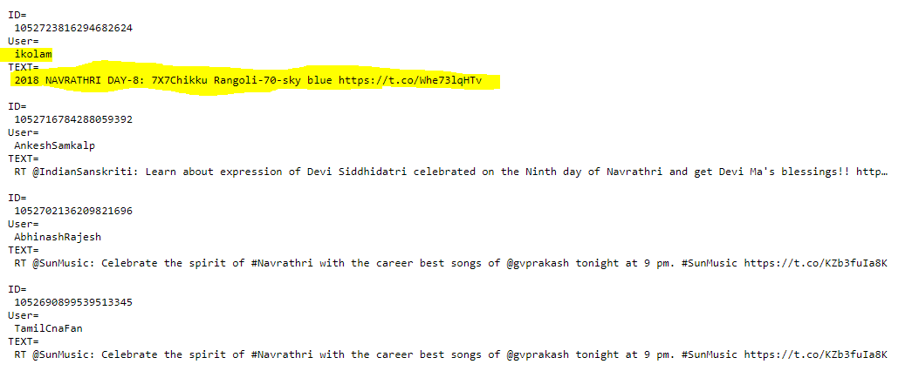
Extracted Real Time Tweets:

Slide 16
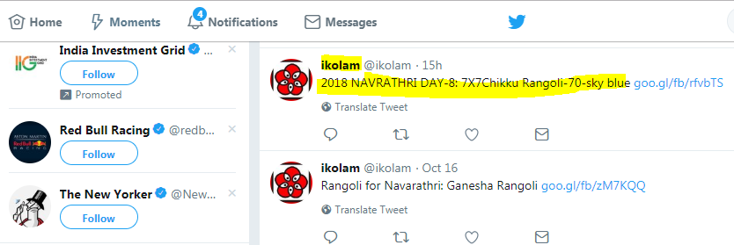
Official Twitter Snapshot of user:

Slide 17
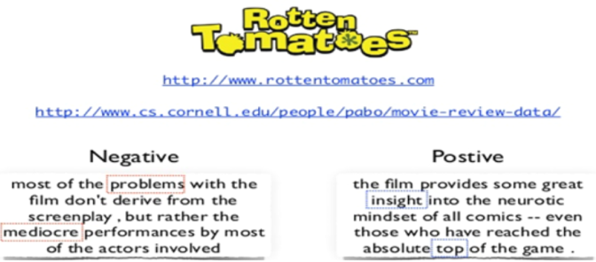
Applications
Used in Movie reviews

Slide 18
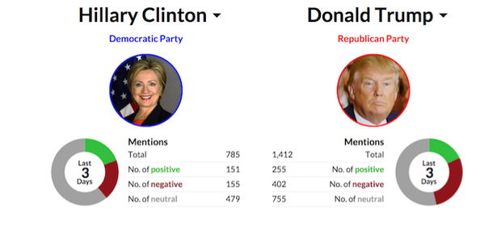
Knowing public opinion for political leader or their notions about rules and regulations

Slide 19
Future Work
Using different other models and algorithms.
Temporal analysis can be added as a future work in the project.
Consideration of Retweets as a factor.

Slide 20
Reference :
????

Slide 21


